Slide 1
Digitalization and Sector Integration
Energy – Transport:
Status Quo & Opportunities for Sino-German Cooperation
数字化-能源要素整合-交通
现状和中德合作的机遇
Jana Ohlendorf
Sino-German Business Forum “Green Cities-Green Industries-Harbin 2017“ „German Business & Techniology Forum on Industry 4.0 – Digitalization – Green Economy”
Harbin, 16. June 2017

Slide 2



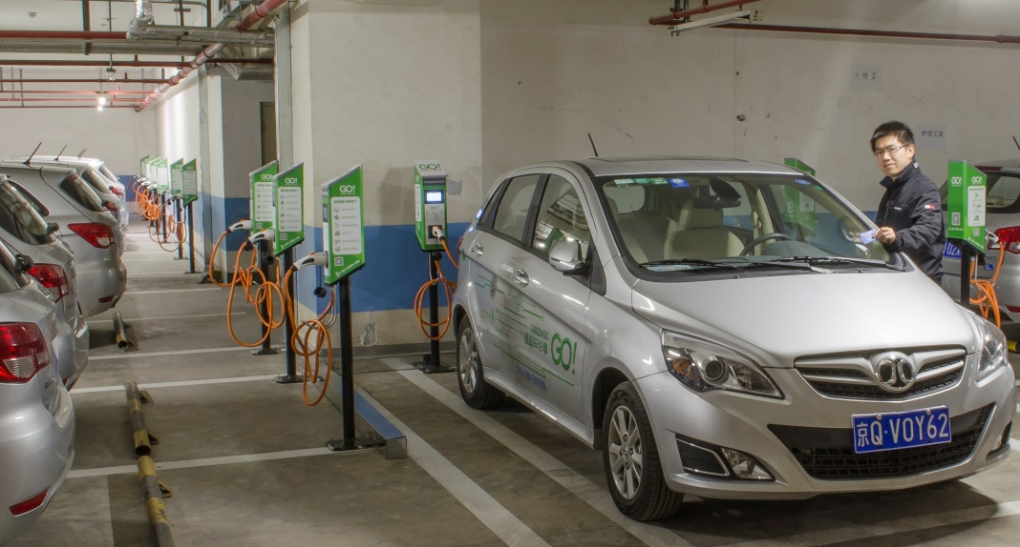
The Digital Revolution is transforming Key Sectors 数字革命是转化的关键因素
Digitalization and Sector Integration Energy – Transport: Status Quo & Opportunities for Sino-German Cooperation
Manufacturing
制造业
Healthcare
健康
Energy
能源
Transport
运输
Jana Ohlendorf, Harbin 16 June 2017

Slide 3
Digitalization and Sector Integration Energy – Transport: Status Quo & Opportunities for Sino-German Cooperation
Contents 内容
Energy, Transport, Digitalization: Political Agenda & Status Quo in Germany and China 能源、交通、数字化：中德政治规划和现状
Digitalization in the Energy Sector 数字化在能源领域
Digitilization in the Transport Sector (Automotive)数字化在交通领域（汽车）
Implications for Sino-German Cooperation in Digitalization and Sector Integration Energy – Transport 对中德能源与数字化方面合作方面的启示 能源-传输
Conclusions & Outlook 结论和展望
Jana Ohlendorf, Harbin 16 June 2017

Slide 4
Digitalization and Sector Integration Energy – Transport: Status Quo & Opportunities for Sino-German Cooperation
Energy, Transport, Digitalization: Political Agenda & Status Quo in Germany
能源、交通、数字化：德国政策规划和现状
Energy能源
  Ambitious renewable energy and energy efficiency targets 可再生能源和能源优化目标
  Energy Concept of the Federal Government (2010) 德国的能源方案
  Climate Action Plan 2050
  气候行动方案2050
  Comprehensive legal framework
  法律框架
  EU Climate and Energy targets
  欧盟气候和能源目标
  ...
Source: Arbeitsgemeinschaft Energiebilanzen, 2015; Bundesministerium für Wirtschaft und Energie (BMWi), Zahlen und Fakten Energiedaten, 2016; Erneuerbare-Energien-Gesetz
Jana Ohlendorf, Harbin 16 June 2017

Slide 5
Digitalization and Sector Integration Energy – Transport: Status Quo & Opportunities for Sino-German Cooperation
Energy, Transport, Digitalization: Political Agenda & Status Quo in Germany
能源、交通、数字化：德国政策规划和现状
Transport (Automotive)交通（汽车）
  Energy Concept of the Federal Government for the Transport Sector德国政府的交通能源方案
  Mobility and Fuel Strategy of the Federal Government
  德国政府的汽车和燃料战略
  National Electromobility Development Plan 国家电动汽车发展计划
  Legal framework, e.g. Regulation on charging stationsand and German Standardization Roadmap for Electromobility
  法律框架：充电桩规则和德国电动汽车标准化路线图
  EU Transport Strategy 欧盟交通战略
  ...
Source: Bloomberg New Energy Finance
Jana Ohlendorf, Harbin 16 June 2017

Slide 6

Digitalization and Sector Integration Energy – Transport: Status Quo & Opportunities for Sino-German Cooperation
Energy, Transport, Digitalization: Political Agenda & Status Quo in Germany
能源、交通、数字化：德国的政策规划和现状
Digitalization 数字化
  Digital Strategy 2025 数字战略2025
  Emerging legal framework: e.g. German Act on Digitization in the Energy Sector (2016) supports the development of a digital infrastructure: smart grids, smart meters and smart homes
  法律框架：德国能源数字行动计划2016
  Activities at the Länder-Level: e.g. Saxony-Anhalt: developing a digitization strategy by 2017
  联邦州的层面：萨安州的数字发展战略2017
  ...
Jana Ohlendorf, Harbin 16 June 2017

Slide 7
Digitalization and Sector Integration Energy – Transport: Status Quo & Opportunities for Sino-German Cooperation
Energy, Transport, Digitalization: Political Agenda & Status Quo in China
能源、交通、数字化：中国政治规划和现状
Energy能源
  Ambitious renewable energy and efficiency targets 可再生能源和能源优化
  Potentially largest investor in energy (and electromobility!) sectors worldwide最大规模潜在的能源领域投资（电动汽车）
  Five-Year-Plan 2016-2010; on energy; + individual Plans (e.g. power market, coal, gas, hydro, wind, solar etc., buildings, electromobility) 五年计划2016-2010， 能源+个性化计划（能源市场、煤、气、风能、太阳能，建筑、电动汽车）
  ...
Source: Bloomberg New Energy Finance
Jana Ohlendorf, Harbin 16 June 2017

Slide 8
Digitalization and Sector Integration Energy – Transport: Status Quo & Opportunities for Sino-German Cooperation
Energy, Transport, Digitalization: Political Agenda & Status Quo in China
能源、交通、数字化：中国政治规划和现状
Transport (Automotive)交通（汽车）
  FYP for the transport sector 交通领域的FYP
  Mid-to-long-term plan for the automotive industry (April 2017) 汽车工业中长期计划
  Made in China 2025: electromobility as one of ten key economic sectors 中国制造2025 电动汽车作为十大主要经济要素
  Government support for R&D 政府支持的研发
  ...
Jana Ohlendorf, Harbin 16 June 2017

Slide 9
Digitalization and Sector Integration Energy – Transport: Status Quo & Opportunities for Sino-German Cooperation
Energy, Transport, Digitalization: Political Agenda & Status Quo in China
能源、交通、数字化：中国政治规划和现状
Transport (Automotive) (ctd.) 交通（汽车）
Source: Bloomberg New Energy Finance

Slide 10
Digitalization and Sector Integration Energy – Transport: Status Quo & Opportunities for Sino-German Cooperation
Energy, Transport, Digitalization: Political Agenda & Status Quo in China
能源、交通、数字化：中国政治规划和现状
Transport (Automotive) (ctd.) 交通（汽车）

Slide 11
Digitalization and Sector Integration Energy – Transport: Status Quo & Opportunities for Sino-German Cooperation
Energy, Transport, Digitalization: Political Agenda & Status Quo in China
能源、交通、数字化：中国政治规划和现状
Transport (Automotive) (ctd.) – Electromobility - Battery production
交通（汽车）-电动汽车-电池的生产
Benchmark Mineral Intelligence

Slide 12
Digitalization and Sector Integration Energy – Transport: Status Quo & Opportunities for Sino-German Cooperation
Energy, Transport, Digitalization: Political Agenda & Status Quo in China
能源、交通、数字化：中国政治规划和现状
Digitalization数字化
  Made in China 2025; Automation & Digitalization
  中国制造2025：自动化和数字化
  Digital Economy -> BAT 数字经济
  Internet of Energy 能源的互联网
  Digital Ecosystems in the automotive sector innovations, start-ups 汽车领域数字生态系统
  ...
“A Robot Revolution, This Time in China”
https://mobile.nytimes.com/2017/05/12/business/a-robot-revolution-this-time-in-china.html?referer=https://t.co/Yz9yUss4e8
“China's aim to establish a national standard could speed the implementation of driverless cars in the world's biggest auto market.”
http://mobile.reuters.com/article/idUSKBN14A106
“China‘s corporations are keen to develop a digital ecosystem in the automotive industry (...) http://www.zeit.de/2017/06/china-automobilproduktion-elektroauto-deutsche-manager/komplettansicht
Jana Ohlendorf, Harbin 16 June 2017

Slide 13
Digitalization and Sector Integration Energy – Transport: Status Quo & Opportunities for Sino-German Cooperation
2. Digitalization in the Energy Sector
Paradigm Shift in the Energy System Drives Digitization
能源系统转型推动了数字化的发展
Before
After
Centralized
Production
Services
Power Plant
Generation
Storage
Paradigm Shift
E-Mobility
Transmission
Distribution
Smart Grid
Grid
Smart Home
Demand
Consumption
Distributed
Production
Consumer
Markets
Generation according to demand
Consumption according to supply
Jana Ohlendorf, Harbin 16 June 2017

Slide 14

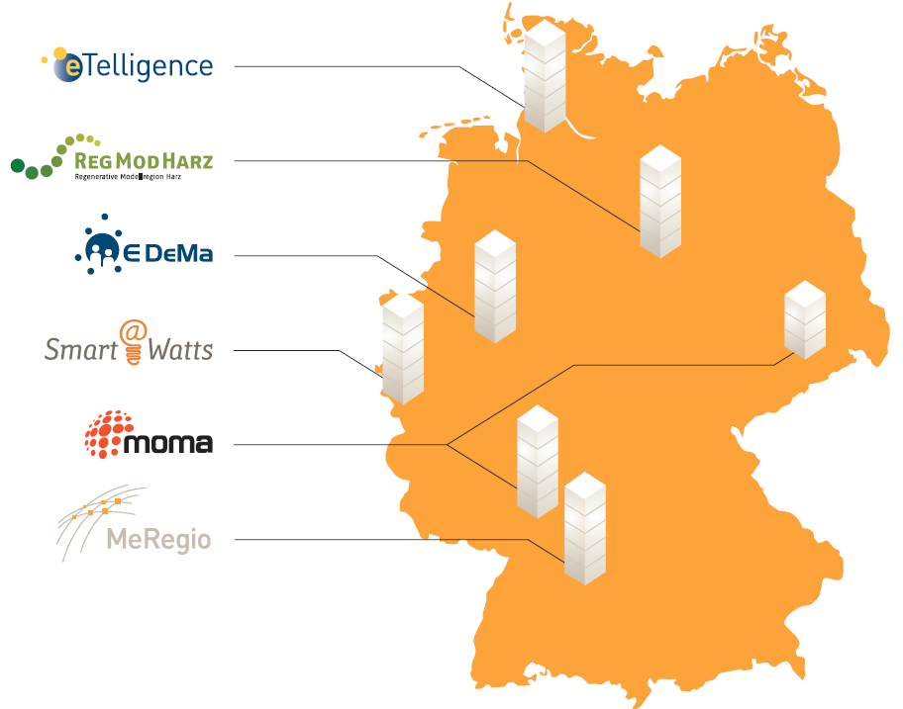
Digitalization and Sector Integration Energy – Transport: Status Quo & Opportunities for Sino-German Cooperation
2. Digitalization in the Energy Sector 能源领域的数字化
Internet of Energy Pilots in Germany (E-Energy)
德国“能源互联网”试点 (E-Energy项目)
Smart Energy made in Germany
Development and testing of hard-ware and software for smart grids 开发和测试智能网格的软件
Accumulating knowledge on interoperability, safety and usabilityss models, processes and pro积累相关知识
Development of business models 开发商业模型
Identification of needs for changes in legal framework
确认需要变更的法律框架
Improvement of consumer awareness and acceptance
推动消费者的认知和接受
Source: Bundesministerium für Wirtschaft und Energie (BMWi), Smart Energy made in Germany, 2014
Jana Ohlendorf, Harbin 16 June 2017

Slide 15
Digitalization and Sector Integration Energy – Transport: Status Quo & Opportunities for Sino-German Cooperation
2. Digitalization in the Energy Sector 能源领域的数字化
  Digitization – use of ICT – essential for leveraging flexibility potentials (balancing demand and supply) 数字化-ICT的应用-平衡需求与供给
  Research and large-scale demonstration projects drive innovation in policy, technology and business models for the Internet of Energy
  研发和大型项目的展示能源互联网的政策和技术以及商业模式
  Standardization reduces costs for adoption of new technologies
  标准化降低了新技术引进的费用
  Legal framework conditions need to be adapted to drive transformation 法律框架条件需要适应变化
  A variety of staekholders needs to be consulted in the process
Jana Ohlendorf, Harbin 16 June 2017

Slide 16
Digitalization and Sector Integration Energy – Transport: Status Quo & Opportunities for Sino-German Cooperation
3. Digitalization in the Transport Sector (Automotive)
交通领域的数字化（汽车）
  Automation 汽车
  Connected Car 连接的汽车
  Self-driving vehicles 自动驾驶汽车
  Mobility concepts 汽车发展方案
  Electric Vehicle and Storage moving Smart Grid Forward 电动汽车和储存
  “Electric Mobility Showcase”
  电动汽车展示箱
In the future, the Digital Ecosystem of a car (over the lifetime of the car) will potentially generate more revenue than simply selling the car.
(KPMG: Global Automotive Executive Survey 2017)
Smart Grid
Electric Vehicle
Energy Storage
Jana Ohlendorf, Harbin 16 June 2017

Slide 17
Digitalization and Sector Integration Energy – Transport: Status Quo & Opportunities for Sino-German Cooperation
4. Implications for Sino-German Cooperation in Digitalization and Sector Integration Energy
在数字化和能源整合领域中德合作的启示-交通
Status Quo
Shared goals: green economy, clean and secure energy supply
共同目标：绿色经济、清洁和安全能源供应
Similarities in Industry 4.0 and Made in China 2025
相近的目标：工业4.0和中国制造2025
Similar opportunities from linking the energy and transport/ automotive sectors相近的机遇来自于能源、交通/汽车
-> Relevance of Digitalization, ICT for key industries and as an enabler of strengthening those links 数字化、ICT作为工业制造的关键
Similar cross-cutting issues and interests 相近的主题和利益
Existing cooperation in economy, policy and science 经济、政治和科学方面紧密合作
Jana Ohlendorf, Harbin 16 June 2017

Slide 18
Digitalization and Sector Integration Energy – Transport: Status Quo & Opportunities for Sino-German Cooperation
4. Implications for Sino-German Cooperation in Digitalization and Sector Integration Energy –Engery 数字化和能源整合领域中德合作的启示-能源
ENERGY: 能源
....
  Renewables integration & smart grids: 可再生整合和智能网格
    Enabling infrastructure:
      Grid technology & power electronics, e.g.:网格技术和电力
        Network control technology (e.g. regulators for dynamic peak shaving)电网控制技术
    Digital infrastructure/ (smart-)grid-related software, e.g.:数字基础设施（智能网格软件）
      Software for virtual power stations for pooling a variety of decentral energy generators and consumers 对于电站和分散的调节站的软件控制，以平衡供电和用电
    Cooperation on Standards 合作的基础
Jana Ohlendorf, Harbin 16 June 2017

Slide 19
Digitalization and Sector Integration Energy – Transport: Status Quo & Opportunities for Sino-German Cooperation
4. Implications for Sino-German Cooperation in Digitalization and Sector Integration Energy - Transport数字化和能源整合领域的启示-交通
TRANSPORT
  Hardware & Software 软硬件
    Electromotors 发动机
    Charging infrastructure 充电基础设施
    Batteries 电池
    Software/ IT competency/ AI
      (Self-driving) sensors 软件和传感器
  Materials 材料
    Light materials, efficient material mix, composite materials, foundry technolog轻型材料，混合高效材料，合成材料
    High-precision vehicle components
    高精汽车
  Industry 4.0 & Made in China 2025:工业4.0和中国制造2025 Automation & Digitalization: Process Quality and Energy efficiency 自动化和数字化，质量管理和能源优化
  Mobility concepts 可移动性的设计
  Charging infrastructure & grid services 充电基础设施和网格服务
  Cooperation on Standards合作基础
Jana Ohlendorf, Harbin 16 June 2017

Slide 20
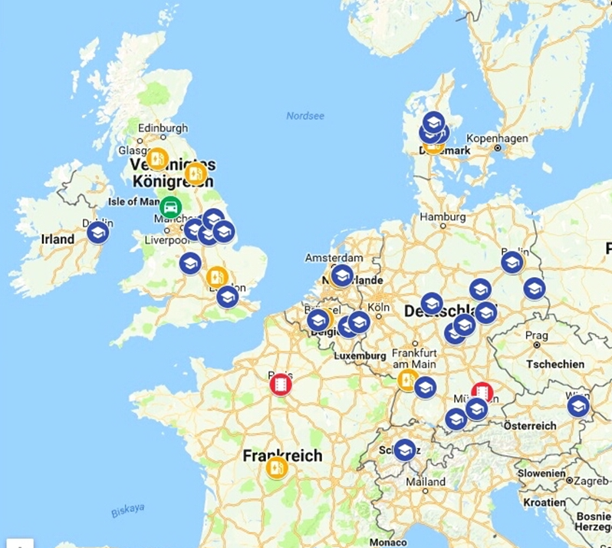
Digitalization and Sector Integration Energy – Transport: Status Quo & Opportunities for Sino-German Cooperation
V2G: Smart grids with two-way-communication between grid and EV 智能网格和网格与EV之间的两相交流
Jana Ohlendorf, Harbin 16 June 2017

Slide 21
Digitalization and Sector Integration Energy – Transport: Status Quo & Opportunities for Sino-German Cooperation
5. Conclusions & Outlook 结论和展望
  Digitalization: enabler for change in key industries 数字化是工业革命的关键
    Potential to strengthen links between energy and transport sectors 加强能源和交通的联系
  Sino-German Cooperation potentials (energy and transport): 中德合作的潜力（能源和交通）
    In business, science and policy 商业、科技和政策
    Topics e.g.: 主题
      RE grid integration -> smart grids 智能网格
      Transport -> e.g. e-mobility, mobility concepts 交通和可移动性
      Standardization 标准化
      Legal frameworks and acceptance 法律框架
      Adaptation of the workforce
  -> Build upon existing cooperation and utilize its potentials
Jana Ohlendorf, Harbin 16 June 2017
Notes:
.

Slide 22
Thank you for your attention!
谢谢您的关注
Digitalization and Sector Integration Energy – Transport: Status Quo & Opportunities for Sino-German Cooperation
Jana Ohlendorf
ohlendorf.jana@yahoo.co.uk
jana.ohlendorf@erlkoenig.de
https://www.linkedin.com/in/jana-ohlendorf/

