Slide 1
Use of waste heat or sun power and their transformation into cooling and useable heat

Slide 2
Basic idea
In the context of industrial manufacturing processes as well as various other procedures often very high temperatures are needed. The resulting waste heat must be exhausted in some form, which regularly takes place via delivery to the surrounding without further use of the inherent energy.
Beyond that often a cooling is within defined manufacturing process steps, necessary from plants, components or closed area etc. Furthermore, there is often demand for cooling within defined manufacturing processes, plants, components or enclosed areas etc.
In the context of operating own power stations, likewise high temperature waste heat emerges, with the need for exhaustion.
The adsorption process presented here uses the developing waste heat and makes the following functions available:
  Transformation of the waste heat energy in cold or heat at the same time or another as well as at the same place or another
  Storage of the waste heat energy
  Supply of cold e.g. for the cooling of plants, components, tools, buildings etc.
_ Supply of useable heat e.g. for the heating, warm water preparation or preliminary heating of media in the context of the manufacturing
It creates further a basis for the pipeline-independent distribution of cold and warmth.

Slide 3

Cooling and heating gain from waste heat
Waste heat
cold
condenser
valve
Evaporator
zeolith-reaktor
pump
pump
valve
fluid-
cooling
pump
valve
pump
heat
valve
Gas burner
pump

Slide 4
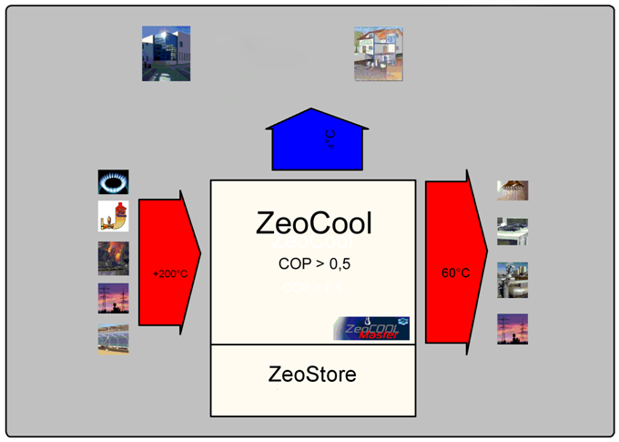
Principle of energy flows

Slide 5
Potential of
Adsorption Energy Conversion Procedure
Substantial saving of energy costs for cooling and heating
Storage of the energy for use, meeting demand contained in the waste heat, (temporal and spatial)
With presence of a power station fuel saving by use of cold for the cooling of the cooling water as well as the warmth to the preliminary heating of the feed water
Substantial reduction of the water consumption for cooling purposes in District Cooling Stations.
Spatial and temporal flexibility in the distribution of warmth and cold .
Marketing of cold weather and warmth

Slide 6
Components
Customer cold
Condenser
Ventils
Evaporator
Zeolite reactor
Pump
Pump
Ventil
Fluid-
kühler
Pump
Ventil
Customer warmth
Pump
Ventil
waste heat
Gas burner
Heat exchanger

Slide 7
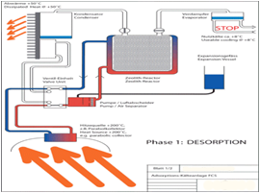
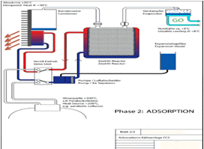
Operational principle
By means of he
Phase 1 – Desorption
By means of heat, water from zeolite minerals is driven out, the zeolite gets " dry"
Phase 2 – Adsorption
Water is again supplied to the zeolite by way of an evaporation process, cold and warmth develop.

Slide 8
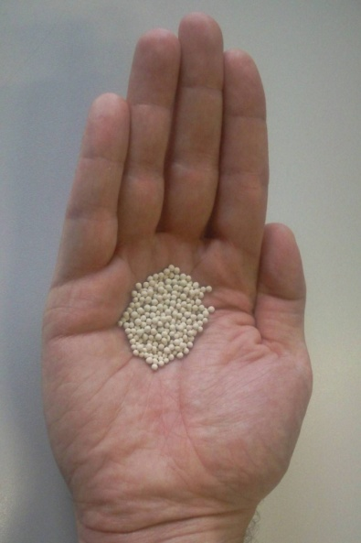
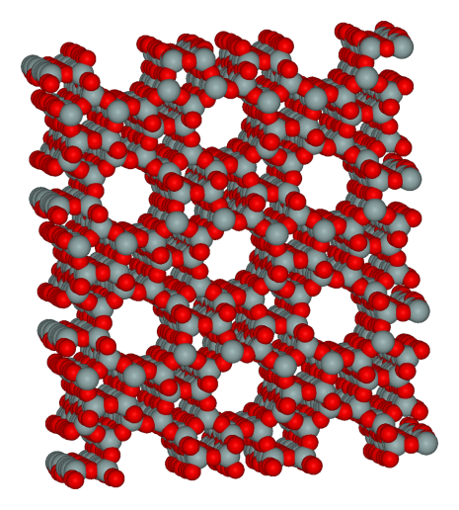
Synthetic zeolite - a fascinating material
Synthetically manufactured mineral
Spherically, innocuously, harmless
Internal surface of a football field in a hand
hand
Industrial mass-produced goods, use for/as
Ion exchanger for water softening
  EDTA substitute
  Molecular sieves
  Desiccator
Industrial catalysts
  Production of detergents
Other materials in particular water can deposit („to adsorb “), energy becomes free
Freely („desorb) with heating in particular water gives bound materials, likewise energy becomes free

Slide 9
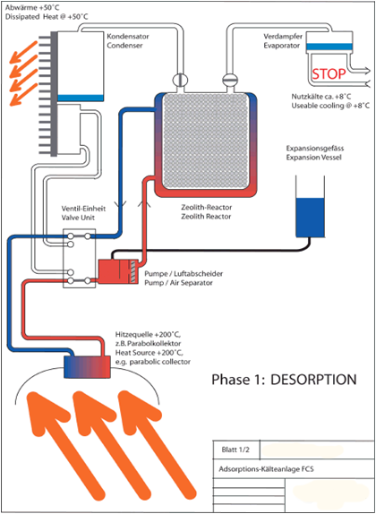
Operational prinziple Adsorption Cooling
Phase 1: Desorption
The zeolite reactor is filled with zeolite, which far defined water content does not possess
In zeolite reactor, condenser and evaporator a vacuum near condition prevails.
The zeolite reactor is surrounded by a liquid, which is moved in a closed circulation system.
Over a heat exchanger this liquid is heated up on 200°C or more (waste heat power station) and then get pumped through the reactor.
Zeolite takes up the energy and separates thereby completely the water bounded in it in the form of water varpourof
The water vapour is liquefied in the condenser
Over a pressure control system the temperature in the condenser can be regulated within the range of for instance 50°C to for instance 150°C.
This warmth can be transferred either to the environment or used otherwise.
Now the zeolite reactor is „loaded “, zeolite is „dry “.

Slide 10
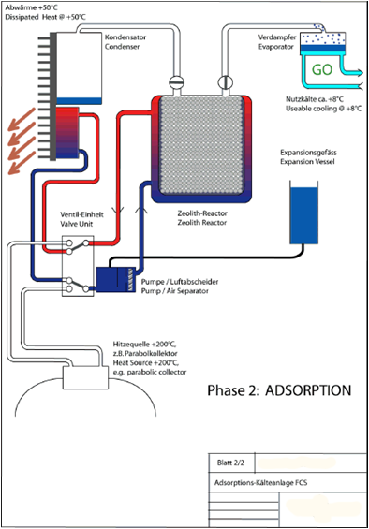
Operational prinziple Adsorption Cooling
Phase 2: Adsorption
After the desorption “dry“ zeolite is in the reactor, it is still hot.
The reactor is cooled down after the desorption, as the warmth is dissipated over the liquid surrounding it and transferred to the environment or used otherwise..
In the evaporator is distilled water.
The valve to the evaporator is opened.
Into this contained water by zeolite one tightens.
In order to arrive in zeolite, the water must evaporate.
For this necessary energy pulls the water from its environment, this is cooled down on for instance 4°C.
Developed cold can be further used.
The water is gathered in the zeolite, heat develops.
This warmth will be shifted with the help of the liquid surrounding the reactor and discharged and released to the environment or otherwise used.

Slide 11
Integration of the zeolite reactor in cooling and heating circuits
Zeolite-Reactors can supplement or replace existing cooling and heating systems.
Several zeolite reactors can be combine in series or in parallel.
"Loaded" zeolite reactors can be exchanged during the process and transported to cold or heat consumption points.
This brings a high degree of flexibility and scalability.
The number of required zeolite reactors arise from the desired cooling capacity required and the number and capacity of cold load and warmth load

Slide 12

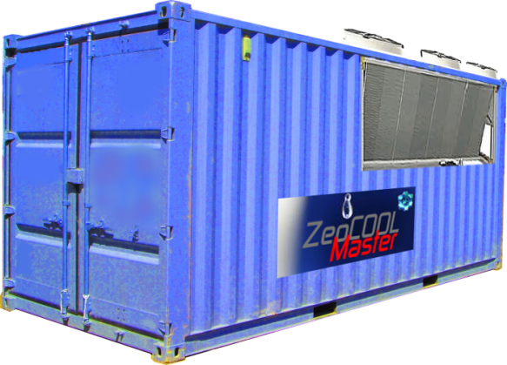
Product concepts
ZeoStore/ZeoCool GrandMaster
Portable storage reactor, condenser and evaporator in a housing. Is charged at the place of existing waste heat of 200 ° C or more.
Size of a standard 20 ‘ container or euro-pallet size.
Quick couplings for thermal fluid and water circuits.
Designed for energy conversion as an ongoing process
Storable thermal energy in the heat ZeoCool Grandmaster 3960 kWh.
Power point capacity 230V / 1.000WH
Heat of combustion gas as an option or addition to the waste heat conversion. eat of gas as

Slide 13

Distribution of energy independent of time and place
Ceolite
Container
Cold / warmth use of
Industrial plant
Charging the zeolite reactors in power plants
Or charging the zeolite reactors in industrial plants
If necessary, decentralized recharge the zeolite reactors at the district heating network
transporting of charged reactors zur Warmth-/Cold consumption point by truck, rail, etc.
Connecting with Warmth-/Cold-distribution system
Return of the unloaded reactor at the power plant
Recharging of the reactor in the power plant
Clicking on TRANSLATE will begin
the download of the TranslatorBar Toolbar.
….
Industrial plant
Waste-heat
recovering
Ceolite Box
Cold-/Warmth-Use of
Building
Ceolite Box
Ceolite
Container
Cold-/Warmth-Use of
Building
Cold-/Warmth-Use of
Residential area

